Slide 1

Chessgames Winter Chess Term 2015 Sprint 3 Presentation

Slide 2
Presentation Outline
What we accomplished
Demonstration of code
Next sprint’s plans
Q&A
Collect feedback (sticky notes)

Slide 3

What we accomplished
Chess clock integration
Algebraic notation
Move history
Updated control styles
Updated presentation layer layout
Created settings page
Integrated country flags
Move validation

Slide 4
Code
Chess clock integration

Slide 5
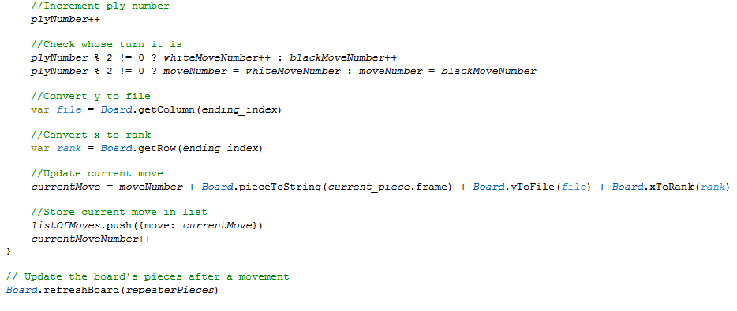
Code
Algebraic notation

Slide 6
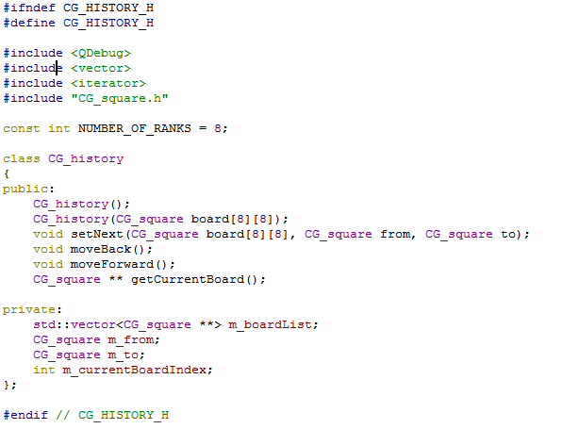
Code
Move history

Slide 7
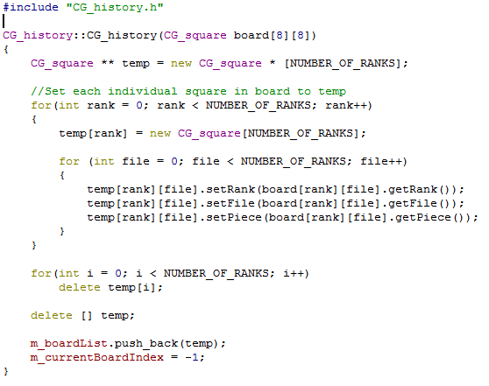
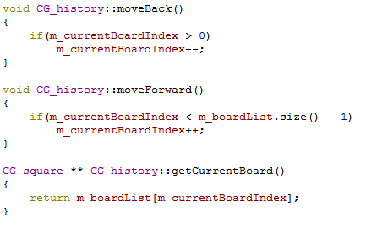

Slide 8
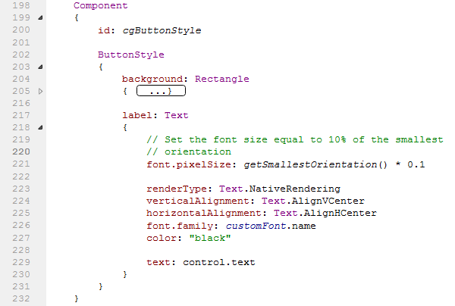
Code – updated control styles
Button Style in CG_settings

Slide 9
Code
Updated presentation layer layout

Slide 10
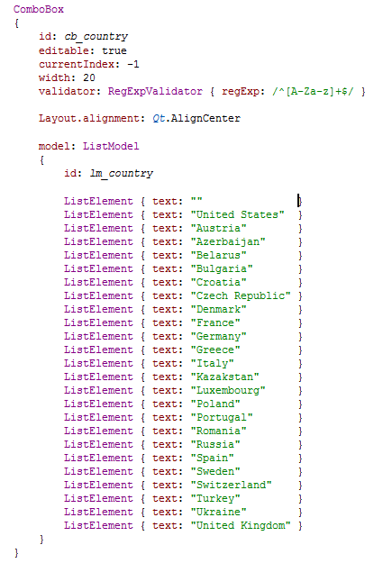
Code – Settings

Slide 11
Code
Integrated country flags

Slide 12
Code
Move validation

Slide 13
Demonstration of code

Slide 14
Plans for Next Sprint
Client to interface with our server (players can play against each other)
Customized piece sets and adding features to settings
Finishing complex move validations

Slide 15
Q &A

Slide 16
Conclusion

